Slide 1
SLOA Annual General Meeting
29 November 2022
Logo Designed by : skydesignworks.com
Notes:
‹#›

Slide 2
Agenda
AGM 2022
Introduction of the Board
Approval of Agenda
Approval of Minutes from last AGM​
2022 Annual Community Update
2022 Amenities
2022 Financial Report
2023 Annual Budget​
Election of 2023 Board
Notes:
Mark
‹#›

Slide 3
Introducing the Board
2022
AGM 2022
Mark Saulnier (President)
Sandi Bonini (Treasurer)
Lena Grygoryev (Secretary)
Doug Thompson
Marc St. Pierre
Anu Joseph
Joseph Furo
Notes:
Mark
‹#›

Slide 4
Opening Motions
AGM 2022
Motion 1: to approve the 2022 SLOA AGM agenda
Motion 2: to approve the minutes from the AGM held 25 November 2021
Notes:
Mark
‹#›

Slide 5
Annual 2022 Report
Year in Review
Notes:
Mark
Hand over to Dan Anderson - a pillar in our community
‹#›

Slide 6
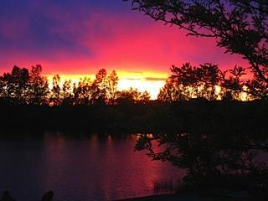
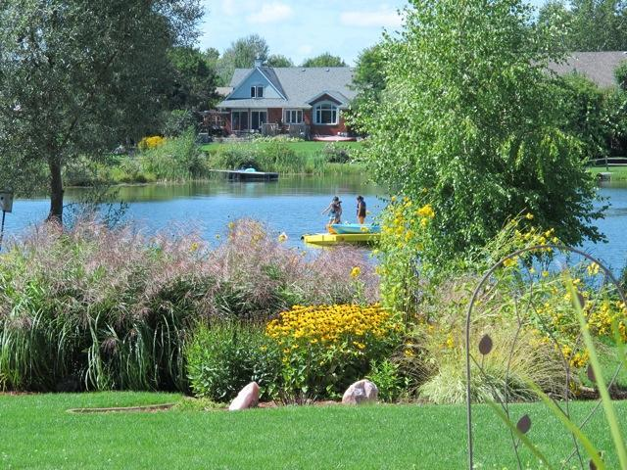
Lakes & Ponds Committee
AGM 2022
Introduction and Committee Objectives
2022 Water Sampling Results and References to Guideline Limits
2022 Individual Lake Reports
Notes:
Dan
‹#›

Slide 7
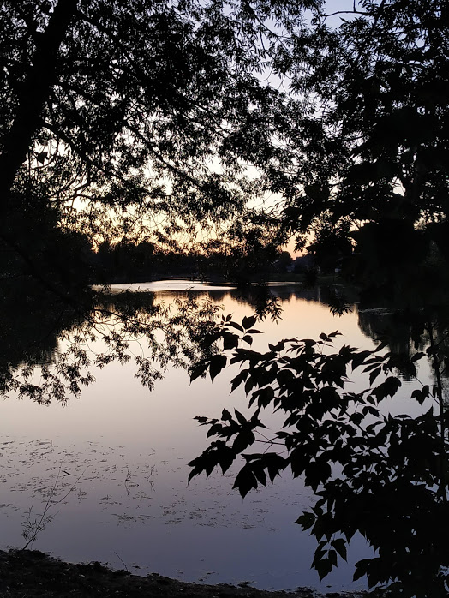
Lakes & Ponds Committee
AGM 2022
Stewardship
The committee has established a number of major objectives, the first being stewardship. Members of the committee are located on each of the four lakes and are engaged in ongoing attention to the particular needs of their waters and recruiting neighbours. This has proven effective and we have five members currently on the committee. The first initiative is to oxygenate the lakes and we currently have systems purchased by SLOA for operation in each of the four lakes. The success of this program has been consistently reported by the stewards in improving water quality, clarity, and inhibited weed growth. We acquired one surface aerator for Twin Lake which was installed by Jody Curran. It may still be necessary to acquire 1 or 2 units in the future to round out the effectiveness of this program, further keeping an eye on progress.
Notes:
Dan
EACH OF THE 4 LAKES HAVE A REPRESENTATIVE
‹#›

Slide 8
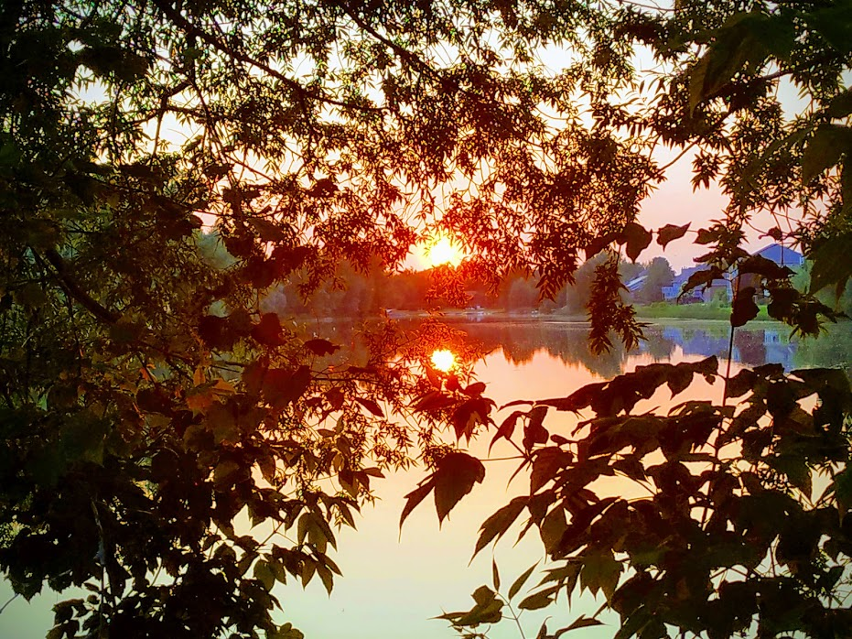
Lakes & Ponds Committee
AGM 2022
Vegetation Removal
The Committee’s second objective is vegetation removal. Any organic matter that enters or grows in the pond must either decay and escape as carbon dioxide or be removed prior to decay. Accordingly, removing as much vegetation as possible limits the demand for oxygen uptake and increases water quality and clarity.
There are also annual water samplings conducted. While these results have indicated that the water quality is good, it does not reduce the need for attention to the maintenance of the health of the lakes as a basin for stormwater collection.
Notes:
Dan
VEGETATION REMOVAL WOULD BE A HUGH COST FOR VERY LITTLE RESULTS BECAUSE THE CURRENT SYSTEM IS WORKING WELL. WE WILL ALWAYS HAVE VEGETATION ALONG THE SHORE LINE SO IT IS INDIVIDUALS ON THE LAKES RESPONSIBILITY TO CONTROL THE GROWTH OFF OF THEIR PROPERTY LINE.
‹#›

Slide 9
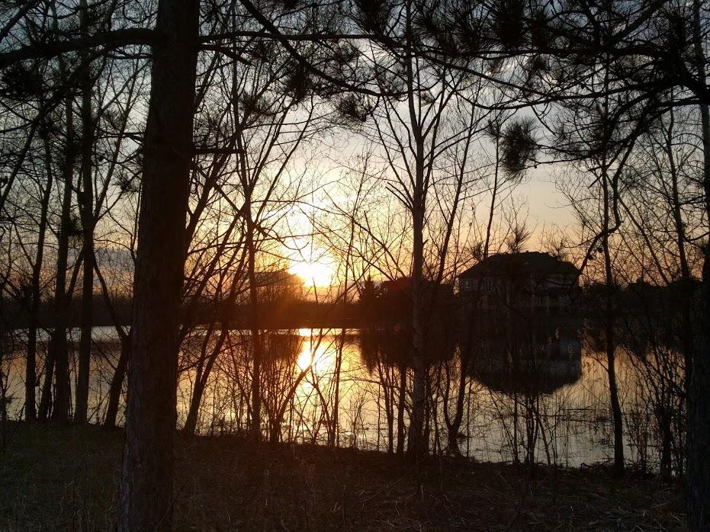
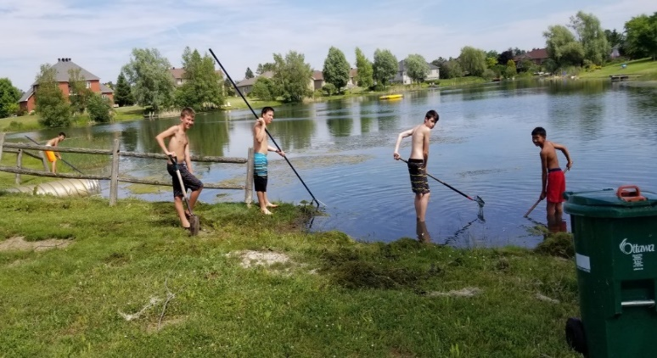
Lakes & Ponds Committee
AGM 2022
Encouraging community
support and participation
The final objective is encouraging community support and participation. It is important that communication with residents directs people to use organic fertilizers with very low nitrate and phosphorus components as well as regular maintenance repair and replacement of septic systems. SLOA has done an excellent job of these communications in the past and it is hoped that the Association will continue to keep residents well informed of all homeowners’ commitment to maintenance of water quality
Notes:
Dan
‹#›

Slide 10
Lakes & Ponds Committee
2022 Water Sampling Results
AGM 2022
Lake Sampled Aug 3, 2022 | NITRATE LEVEL (N-NO3) | E. COLI LEVEL
Sunset Lake | <0.10 | 9
Twin Lake | 0.34 | 0
Misty Morning Pond | <0.10 | 171
Waterside Court Pond | <0.10 | 2
Lake Sampled Aug 5, 2022 | NITRATE LEVEL (N-NO3) | E. COLI LEVEL
Misty Morning Pond | <0.10 | 1
Waterside Court Pond | <0.10 | 23
NOTE* There was an immediate second sample taken in the Misty Morning Pond where the e. coli dropped from 171 (which is below the recommended limit of 200 E. Coli per 100mL) to 1.
Notes:
Dan
‹#›

Slide 11
Lakes & Ponds Committee
AGM 2022
References to Guideline Limits
Nitrate:
Ontario drinking water objective for Nitrate is 10.0 mg/L.
Nitrate (inorganic)
The maximum acceptable concentration of nitrates in drinking water is 10mg/L as nitrogen. Nitrates are present in water (particularly ground water) as a result of decay of plant or animal material, the use of agricultural fertilizers, domestic sewage or treated wastewater contamination, or geological formations containing soluble nitrogen compounds.
E. Coli:
The City of Ottawa’s guideline for E. Coli is as follows, “Ottawa Public Health will issue a no-swimming advisory if: the geometric mean of 5 water samples taken on the previous day is greater than 200 E. coli per 100mL of water; or a single water sample test result from the previous day is greater than 400 E. coli per 100 mL; or there is a significant rainfall event”.
Notes:
Dan
‹#›

Slide 12
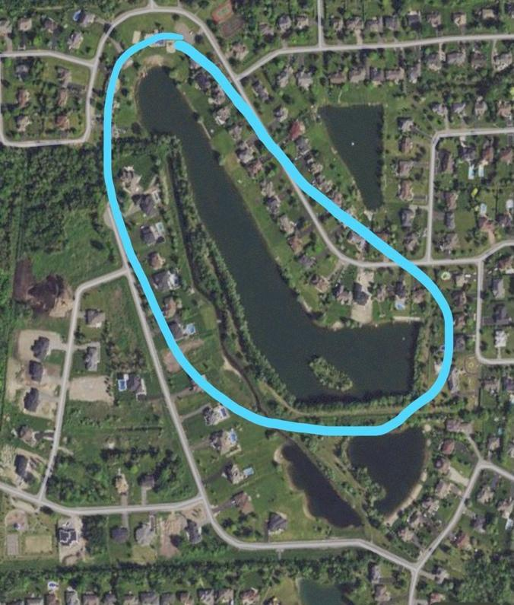
Lakes & Ponds Committee
There are four lakes in the Sunset Lakes Community: Sunset Lake, Twin Lake, Waterside Court Pond (North Pond) and Misty Morning Pond (South Pond). Below are the individual lake reports.
AGM 2022
Sunset Lake
The large lake at Sunset Lakes has a number of important functions. The pool and community beach are located at the north end and daily recreational use including swimming occurs here. The lake is the receiver of much of the storm water for the development and in addition to recreational and aesthetic benefits there are excellent storm water quality and quantity controls afforded by the very large area for storm attenuation.
Originally created by the commercial extraction of sand, the lake was essentially exposed water table. The former sand pit was rehabilitated for the development of Sunset Lakes as a residential community.
The 15 acre area is the ultimate receiver of all runoff from the subdivision and as such could potentially be impacted by excessive nutrients from lawns and septic systems if these were to be released in extreme quantities
Notes:
Dan
‹#›

Slide 13
Lakes & Ponds Committee
Sunset Lake contd.
AGM 2022
This season the water quality has been excellent. Regular measurement demonstrated non detectable nitrates when sampled. (The presence of high nitrate loads could indicate excessive nutrient enrichment from private home sewage or fertilizer.) Fortunately, the health of the lake does not appear impacted in this way and we are approaching 30 years since inception.
E coli was also tested and was also very low.
The success of the aeration program continues to help with good clarity, controlling invasive weeds, removal of carbon sediments and algae control. The success of algae and vegetation control in the two smaller ponds provides some good indication that vegetation removal might be avoided with a good aeration program.
This is by far the largest of the four lakes and it is hoped that the addition of one or two more aeration systems will help improve controls in some of the less accessible areas.
Notes:
Dan
‹#›

Slide 14
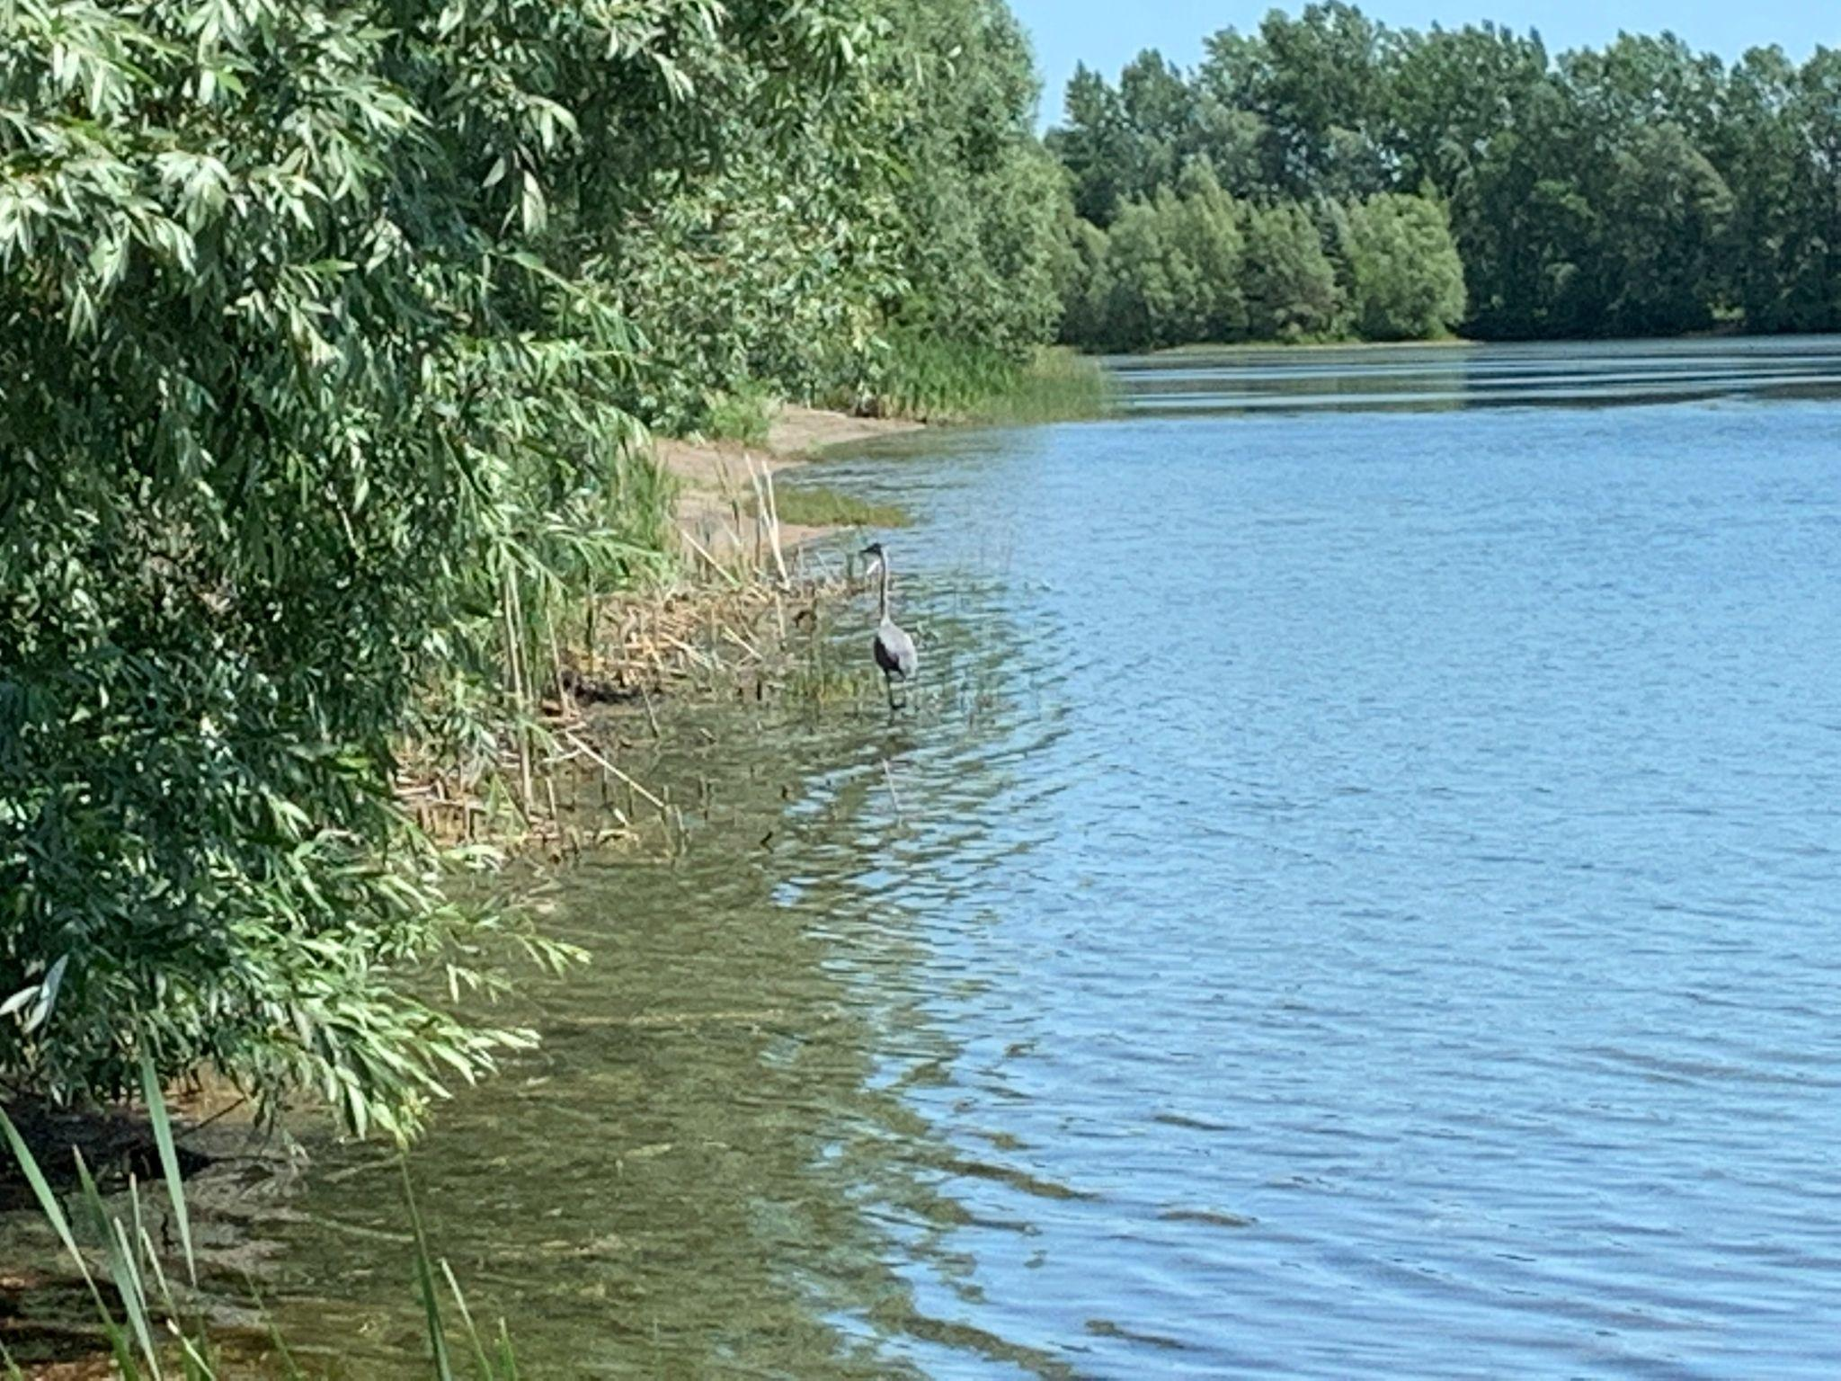
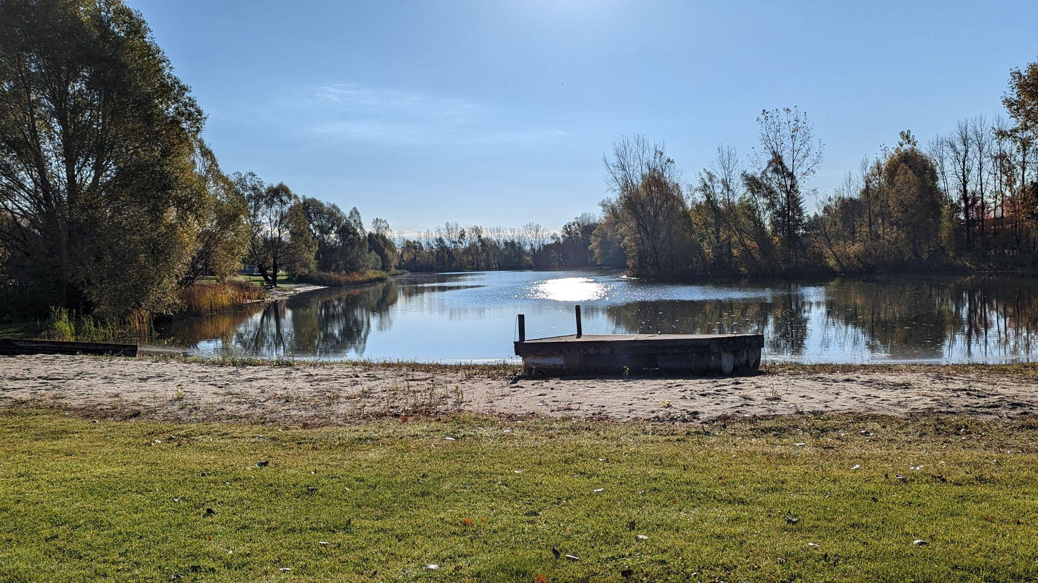
Lakes & Ponds Committee
AGM 2022
Notes:
Dan
‹#›

Slide 15
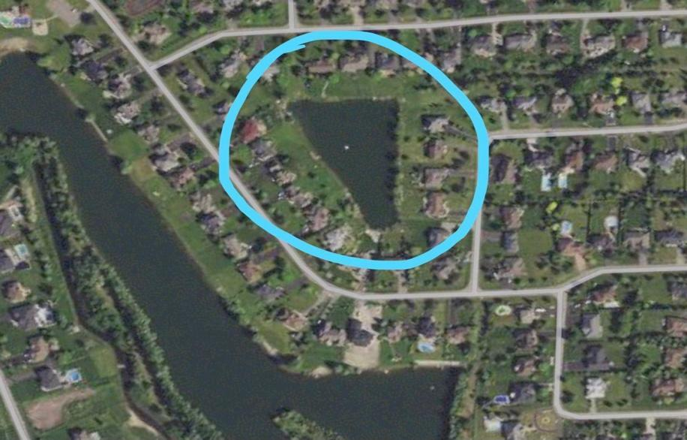
Lakes & Ponds Committee
Twin Lake
AGM 2022
Report: As in previous years, the overall water quality and clarity was very good with low E.Coli and nitrogen levels. There were some algae blooms throughout the spring, summer and fall, but these were similar to occurrences in previous years and perhaps even to a lesser extent. The lake is enjoyed by residents in the summer for kayaking, stand-up paddle boarding and some swimming with a yellow raft anchored in the middle of the lake. There remains an abundance of fish and wildlife in and around the lake.
Despite some success last year in restricting the size of the geese population on the lake and surrounding properties, this past summer saw a "return of the geese" which remain major irritants to the lake and surrounding lakefront properties. For 2023, further deterrents should be explored to reduce the size of the geese population on the lake.
The lake's aeration program consisted of the use of three (3) submerged bubblers located across the length of the lake, a surface aerator located at the south end and a surface bubbler located at the north end. Similar to last year, the compressor powering the 3 submerged bubblers broke down multiple times resulting in the bubblers not running for many weeks at a time. The compressor repairs were coordinated by members of the water quality committee but required repairs at least 3-4 separate times. A new compressor is needed for use in spring 2023.
For 2023, in addition to a new compressor, it would be helpful to dredge weeds from the lake, as the budget allows.
Notes:
Dan
SOME ALGAE AGAIN THROUGHOUT THE LAKE
GEESE CONTINUE TO BE A PROBLEM - REPORT ANY NESTS ON YOUR PROPERITY
NEW COMPRESSOR PURCHASED
‹#›

Slide 16
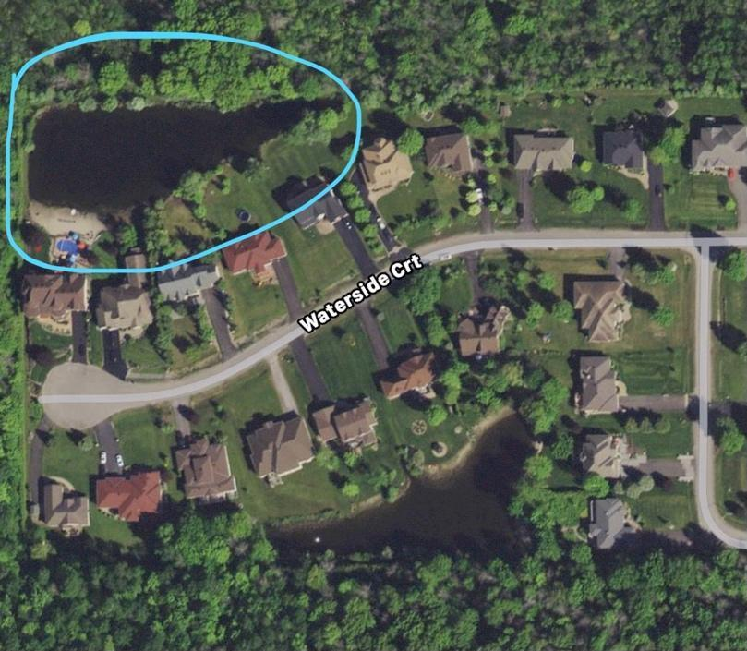
Lakes & Ponds Committee
AGM 2022
North Pond
The north pond has been in a fairly steady-state since the subsurface aerators were installed in 2019. The aerators are run from April to November and appear to be making a difference in maintaining the water clarity. Water quality has been good despite what we believe was an anomalous reading earlier in the season. If there has been a change, it would be an above average amount of algae growth and the appearance of a thick layer of what is likely to be pond scum on the service which has raised concern from some residents. We should plan to evaluate if and how this can be remedied for next season. Also, we have taken steps to remove a significant amount of build up in front of the outlet of the north pond which has accumulated over the years. This was slowing the flow of water through the system to a noticeable degree but is now resolved
Notes:
Dan
TRY TO GET A BETTER CONTROL OF THE POND SCUM IN 2023
AERATORS WORKING WELL
‹#›

Slide 17
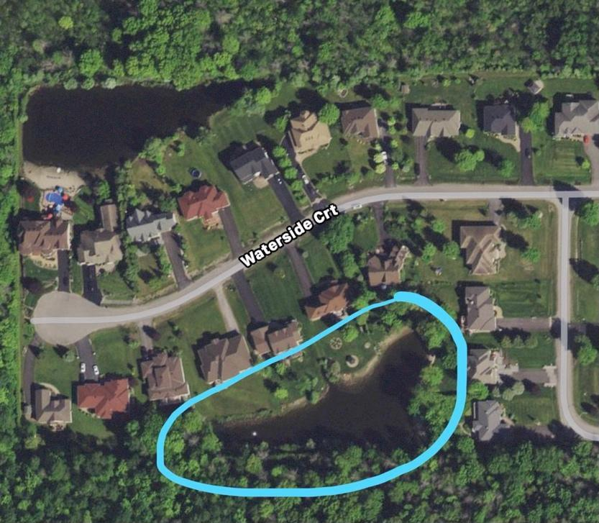
Lakes & Ponds Committee
AGM 2022
South Pond
South Pond stewardship was shared this year by the Hamilton’s and the Holloway’s, each providing power to the two bubblers. Water quality remains high and water levels seemed higher than normal, and high right to the fall. Although the south pond had not ever been dredged, vegetative growth remained well contained.
Notes:
Dan
‹#›

Slide 18
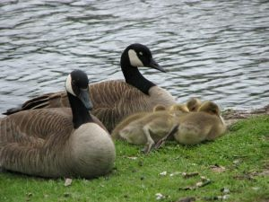
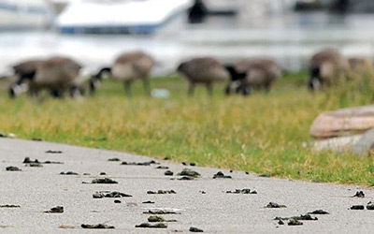
Geese and Ducks
Enemies of the Water Quality !
AGM 2022
Duck and goose feces is a MAJOR contributing factor to poor lake/pond water quality. The droppings increase both e-coli bacteria and unwanted growth of algae.
An adult goose produces approx. 1 kg of 'goose poop' per day
Discourage them from your waterfront property:
remove all food sources and don’t feed
install a goose and duck repelling line along the edge of the water - 1 to 2 feet away from the water’s edge and about 6 inch above the ground, extending along the entire length of your properties. As simple as these lines are, they serve as an effective barrier for geese and ducks
actively discourage them from settling and residing
Notes:
MARC SPEAKING TO THIS
‹#›

Slide 19
Geese and Ducks
Update
AGM 2022
This year again, thanks to a community volunteer Claudia Buttera, we obtained a government permit for geese management.
Thanks to insights gained from the contractor last year, our volunteers were able to take on the task of egg nest finding and oiling of the eggs.
This year the search has been performed, and there was no egg nest found to oil.
Notes:
Marc
Everyone can help by looking for nests around the lakes - we’ll treat them.
‹#›

Slide 20
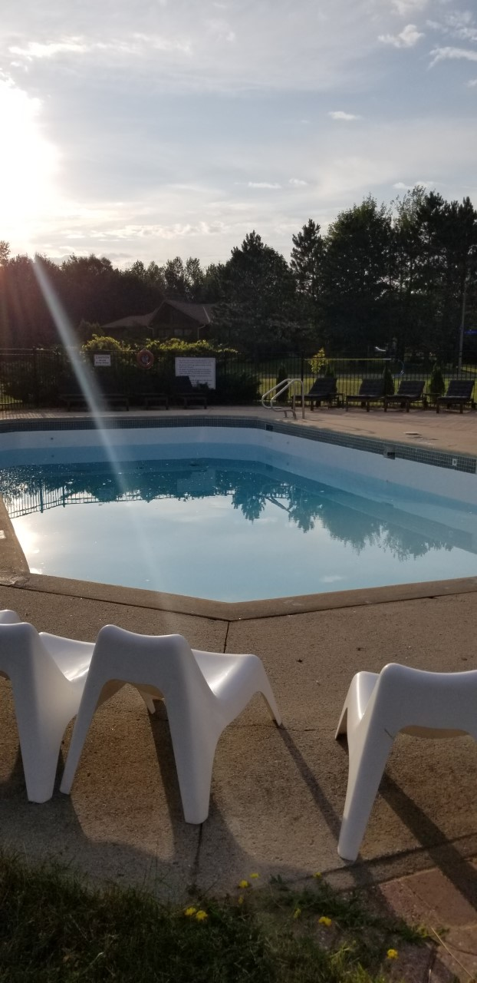
Community Pool
AGM 2022
We had a good long season this year again, opened the day after the city authorized it and closed at the very end of Sept. We did not have any mechanical breakdowns throughout the year that affected the daily operation. And the pool was always heated and cleaned on time. This was of great thanks to the volunteers who tested and cleaned the pool on a daily basis.
Work completed in 2022
Purchased the second NG BBQ to complete the gas upgrade project
Purchased 6 more Adirondack chairs (very popular chairs)
Added a 2 person adult kayak to the beach toys
Installed 2 bicycle racks
Added 3 new picnic tables and umbrellas with heavy duty stands
Repaired and modified the pool cover
Continuously worked on our gate access system – new contractor coming on line to repair the system
Replaced the Sand Filter
Repaired both Canoe seats
Notes:
Mark
Volunteers needed for next year - both students and adults
New gate contract coming to fix the system
‹#›

Slide 21
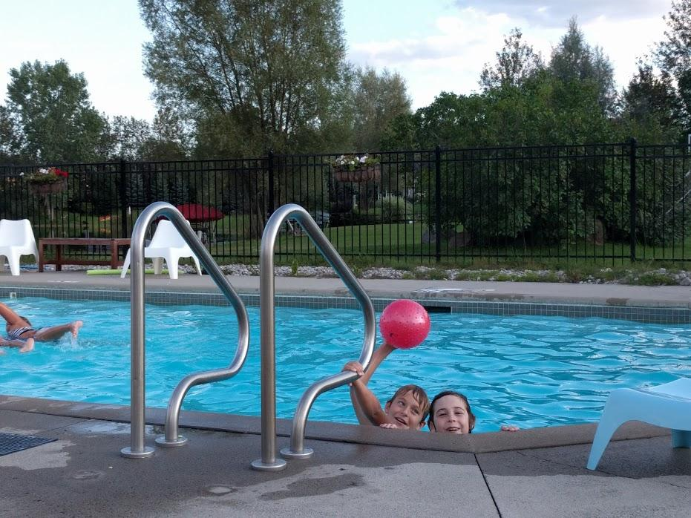
Community Pool
PROPOSED for 2022-2023 Pool Area Development
AGM 2022
Our new Pool Operations representative is Joe Furo. Welcome Joe!
Feedback from members using the pool influenced this list of possible improvements for the community to consider, based on the amount of funds we wish to invest. Cost estimates provided to the Board for consideration.
Purchase and install Rain gutters (to stop patio stone erosion on the front and west side of the pool house)
Investigate the possibility of installing some shade systems for select areas around the pool (without obstructing the lake view as requested)
Plan and prepare to refinish the pool skirt (concrete area around the pool) in a safe rubber material to stop the concrete spalding and allow for proper safety markings to be installed. This will be budgeted and installed in 2024 if approved.
Hire a company to repair the pool FOB system which has been faulty this summer.
Notes:
Joe
‹#›

Slide 22
Common Areas
Beach, Volleyball Ground, Children Playground, Pathways
Work Completed 2022
Beach has been cleaned
Path around lake was cleaned and growth removed and chipped
Key Work Proposed for 2023
New professionally installed basketball net is proposed
Minor asphalt repair on the pathways
Outside pool area: purchase border material (identical to playground border) to define the beach and grass areas for grass cutting and sprinkler set up
Purchase a rototiller for beach maintenance
AGM 2022
Notes:
Marc
Thank Bill Rideout for the chipper work on the trail.
‹#›

Slide 23
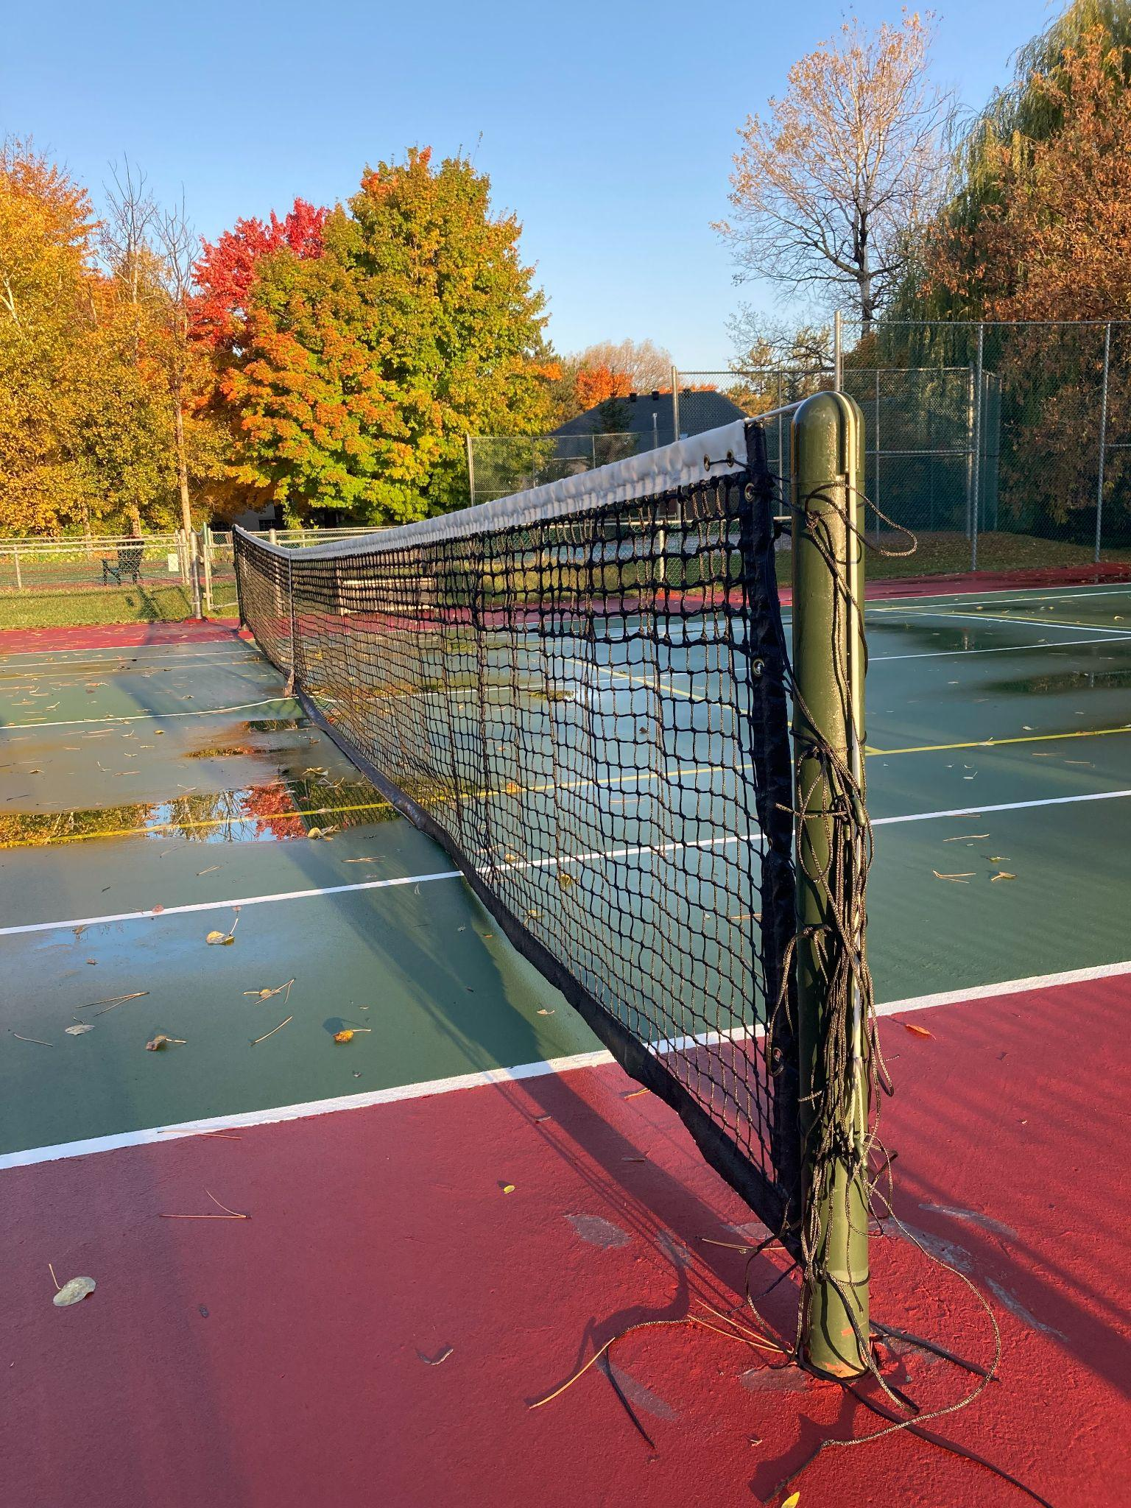
Tennis Courts Update
AGM 2022
2022 saw the newly painted lower court enjoy lots of use by residents. In addition to the new paint job done in 2021, a new net was added to the lower court this year.
The upper court received a professional cleaning by Canada Courts this past July.
And a proper foam roller broom was purchased to remove access water after rainfall from the courts.
Notes:
Marc
‹#›

Slide 24
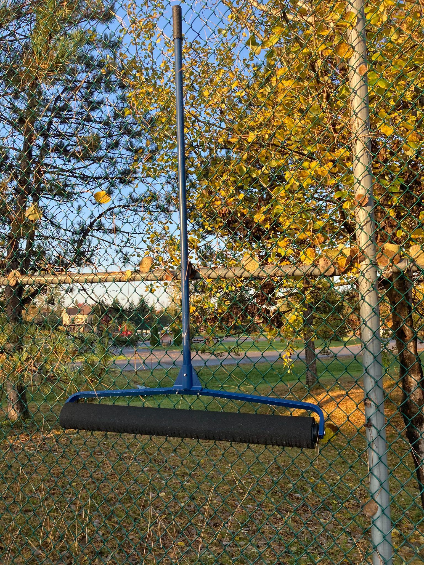
Tennis Courts Update
AGM 2022
Looking forward to 2023, aside from the usual maintenance, we are still hoping to get a new post/net crank for the upper court. This was on the agenda for this year but it never worked out.
Notes:
Marc
‹#›

Slide 25
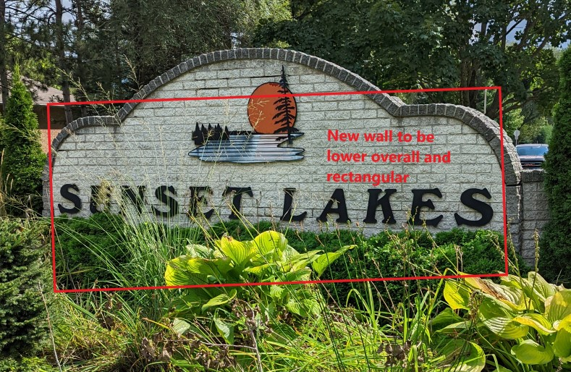
Update on Entrance Sign
AGM 2022
Notes:
Mark
‹#›

Slide 26
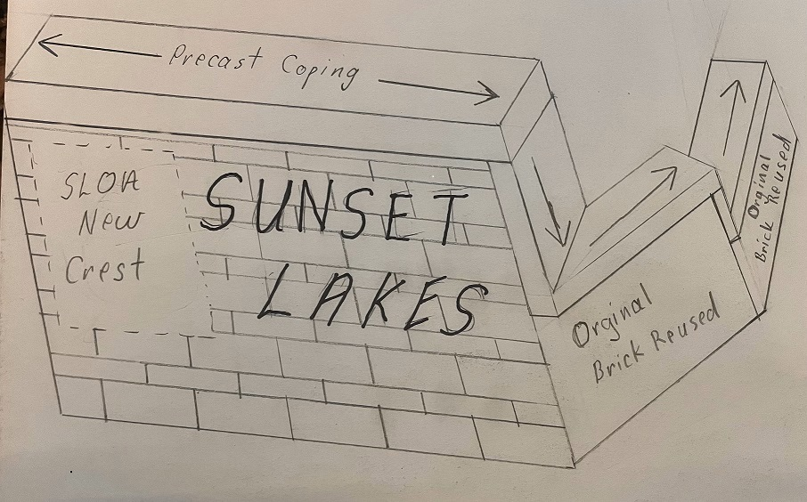
Update on Entrance Sign
AGM 2022
Notes:
Mark
‹#›

Slide 27
Update on Entrance Sign
AGM 2022
At 2020 AGM it was approved to renovate the main sign on Tranquil Gate + a smaller version for the Lakes Park Drive entrance. Cost of $27,050 + HST ($30566.50). Due to the pandemic there was a significant increase to the cost of material as well as a shortage of materials. It was decided by the board to push the project to 2022. Current proposal is as follows;
Reuse portions of the existing brick to repair the side walls and install a new face wall using Adair Limestone. ($25,200)
Manufacture a new SLOA crest to replace the Sunset Lakes Development crest. ($1073)
Refurbish and install the same sunset Lakes lettering. ($638.45)
Stay within the approved budget. ($26,911.45)
That’s $3,300 cheaper than our closet bid for a similar product
Work can be scheduled for May 2023
Notes:
Mark
‹#›

Slide 28
Entrance Sign Motion
AGM 2022
Motion 3:
To replace the Tranquil Gate entrance sign with the design presented today at the AGM at the cost of $27,000. This design and cost will replace the design and cost previously approved at the AGM 2020.
Notes:
Sandi
‹#›

Slide 29
2022 Financial Report
 | Budget 2022 | Projected to year end
Income | 73,500 | 66,586
Operating Expenses
Administration & General | 9,100 | 6,353
Gardens and Landscape | 10,800 | 7,523
Pool Operations | 18,000 | 18,938
Lake Operations | 12,000 | 4,738
Community Events | 1,500 | 436
Repairs and Maintenance (other) | 5,000 | 1,267
Tennis Courts | 2,000 | 368
Walking Trail/Path Maintenance | 2,000 | 787
Total Operating Expenses | 60,400 | 40,410
Allocation to the Reserve Fund | (7,050) | (7,050)
Capital Projects – Tranquil Gate Sign | 30,600 | 0
Net Income/(Loss) | $(24,550) | $19,126
AGM 2022
Notes:
Sandi

Slide 30
Financial Motions
AGM 2022
Motion 4:
To approve the 2022 financial report as presented
Motion 5:
To approve that the Sunset Lakes Owners Association will NOT be appointing an auditor to audit the 2022 financial statements
Notes:
Sandi
‹#›

Slide 31
2023 Fees due January 1st
AGM 2022
The board is suggesting the annual fee will remain the
same for the 2023 year at $500.
A late fee of $50 will be assessed for all residents that are unpaid on January 2nd and then $20 per month for the next three months.
Ways to pay:
e-transfer with auto-deposit is available for your convenience
to: sloa6798@gmail.com - NEW E-MAIL !
Important: please indicate the property address in the comment field
Mail your cheques to:
6798 Lakes Park Drive, Greely, K4P1M6
Please check out our Maintenance Fee Payment Policy
Notes:
Sandi
‹#›

Slide 32
Reserves
AGM 2022
We contribute 10% of total annual fees to the reserve fund each year.
At the end of 2022, the reserve fund will be approximately $135,000.
Notes:
Sandi
‹#›

Slide 33
2023 Budget Proposal
 | Budget 2022 | Budget 2023
Income | 73,500 | 73,000
Operating Expenses
Administration and General | 9,100 | 11,650
Gardens and Landscape | 10,800 | 9,300
Pool Operations | 18,000 | 18,500
Lake Operations | 12,000 | 12,000
Community Events | 1,500 | 2,000
Repairs and Maintenance | 5,000 | 4,000
Tennis Courts/Basketball court | 2,000 | 2,000
Walking Trail/Path Maintenance | 2,000 | 2,000
Total Operating Expenses | 60,400 | 61,450
Net Income/(Loss) after Operations | 13,100 | 11,550
Allocation to Reserve Fund | (7,050) | (7,050)
Capital Projects – Entrance Signs | 30,600 | 30,600
Net Contribution/(Draw on Reserves) | $(24,550) | $(26,100)
AGM 2022
Notes:
Sandi
‹#›

Slide 34
Financial Motions
AGM 2022
Motion 6:
To approve the 2023 Budget.
Notes:
Sandi
‹#›

Slide 35
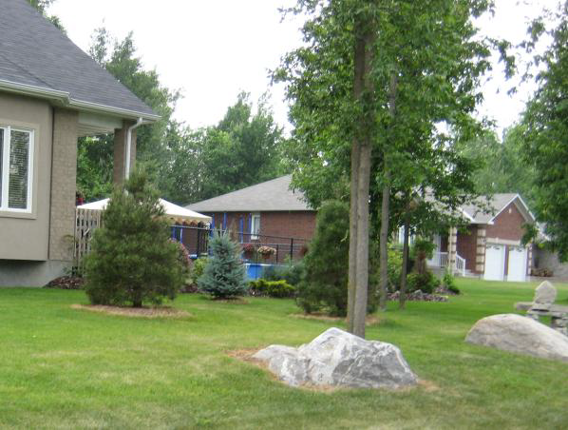
Covenants and Design Review
AGM 2022
DEED RESTRICTIONS... available online @ http://www.sunsetlakes.ca/owners-association-5/owners-association-3/covenants-and-restrictions
All building plans must be reviewed and approved by Design Committee
Waterfront development must be approved
Easements cannot be constrained
No long-term parking of trailers, motorhomes, boat etc over 3 wks
Notes:
Joe
‹#›

Slide 36
Active Covenants Disputes
Fence Dispute
Type of dispute: unapproved fence installed on property. The installed wooden fence also encroaches on two easements (SLOA and City). Also a rear portion of the fence, comprising of chain link fencing and a gate is actually installed on SLOA property (i.e. common area waterfront). As well, a pre-existing wooden shed that was moved on the property is now situated on the aforementioned easements. Finally, without any approval from the City of Ottawa, the residents have altered the outlet of a municipal culvert located on the rear property.
Actions Taken to date: in Sept. and Oct. 2020, the residents of this address were informed that the fence installed on their property violated the SLOA covenants for multiple reasons. Following several correspondences, no corrective action was taken by the residents.
On December 9th, 2020, the residents were sent the results of a title search against their property, paid by SLOA. The title search confirmed the existence of the two easements and also clearly showed that the chain-link fence and possibly a portion of the wooden fence encroach SLOA property. Again, no corrective action was taken by the residents.
In June 2021, SLOA hired a lawyer to send a formal letter to the residents. No corrective action was taken by the residents. Instead the residents offered to submit to a formal conciliation process. This offer was declined by SLOA due to the additional legal expenses that would be incurred. As a counter offer (extended twice), the SLOA board offered to hold an informal conciliation board made of members of the community who are former SLOA board members but not involved in this dispute.
On Nov. 9th, 2021, the lawyer for the residents indicated that his clients are now willing to participate in an informal conciliation process that will be binding on both parties. This meeting is in the process of being scheduled.
From Nov to August 2022 email communications took place between the residence and SLOA culminating with an in person meeting on 11 Aug 22 with lots of promises from the resident but no action was taken to rectify the issues.
In Sept 22 City Bylaw was once again approached and they visited the property but their results were inconclusive - we are currently waiting for a response from Ottawa City Legal department on clarification of the Bylaw results.
AGM 2022
Notes:
Joe
‹#›

Slide 37
Active Covenants Disputes
Fence Dispute
The SLOA board is of the opinion that it has strong position regarding this dispute. Now that the informal conciliation failed to yield a mutually agreeable result, the board will re-engage legal representation and seek a court order to have the fence removed from the SLOA property.
As well, in the absence of any mutually agreed resolution to this covenant violation, the residents are denied the privileges of accessing and/or reserving SLOA common amenities such as the SLOA community pool.
Motion 7:
To approve authority for SLOA Board to secure legal representation to pursue a resolution in reference to the fence at 6906 Lakes Park Drive. Initial amount not to exceed $30,000. If additional funding is needed the Board will come back to the community for approval.
AGM 2022
Notes:
Mark
Legal is the only option to get results
2 lawyers in the community are working with the board to ensure we are being represented fairly (price and action)
‹#›

Slide 38
Community Events
and Social Activities
AGM 2022
The pool area was popular this summer for birthday parties and live music by residents in good standing.
Students were able to earn volunteer hours in the community
We also had some perennial good things like:
Spring and Fall Clean-up Days – Keeping our community beautiful
Sunset Rock Art
Fairy Doors
Free water ski nights
Tennis Lessons
Notes:
Anu
‹#›

Slide 39
SLOA Communications
AGM 2022
All communications from SLOA board are via email sloa@rogers.com
Residents should make sure to provide SLOA with an active email address if they want to receive community notifications
Email addresses collected by SLOA are not shared. All SLOA communications are sent out using blind carbon copy (bcc)
SLOA email distribution list is used ONLY for the information that is pertinent to the ENTIRE community (examples: lost/found items or pets, vandalism/public safety concerns, SLOA organized activities)
SLOA distribution list IS NOT used for personal services ads, charitable causes, fundraisers, house sitting, etc., no matter how laudable or beneficial the cause
Such messages are allowed and welcome on our “SLOA” Facebook Group (Please join!)
Notes:
Doug
‹#›

Slide 40
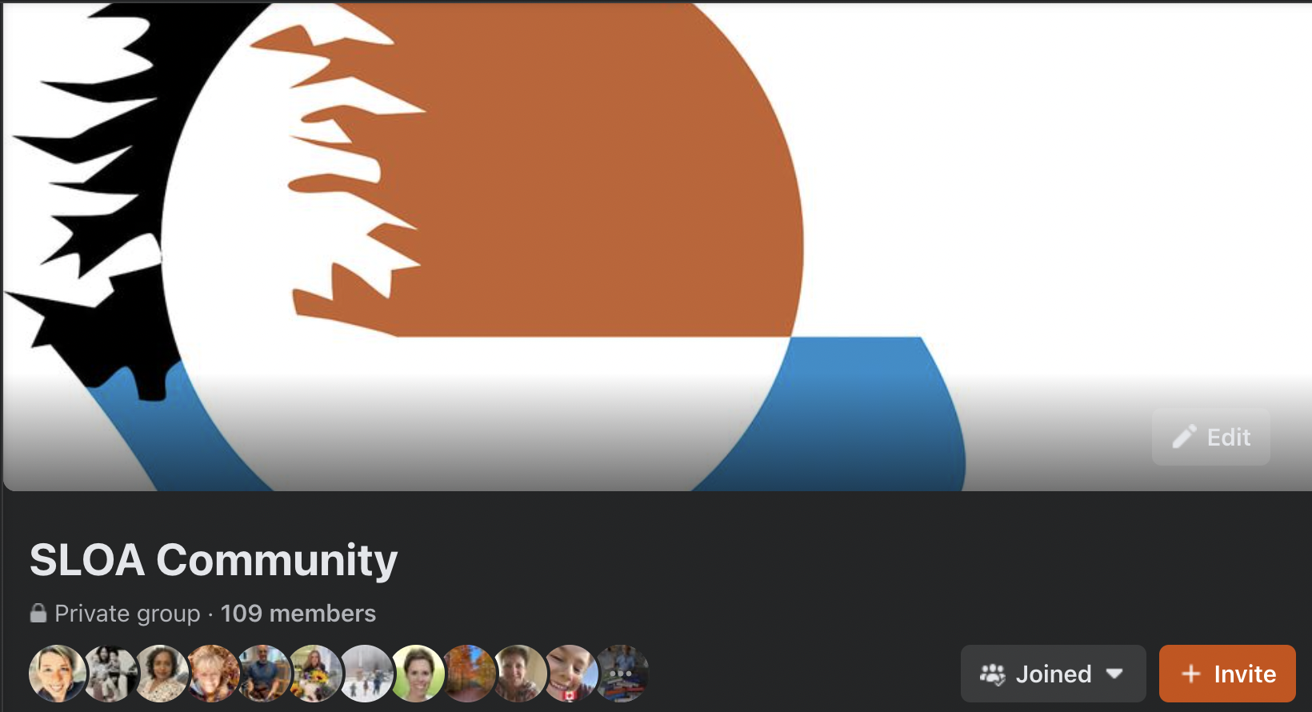
SLOA Communications
AGM 2022
We have a Facebook Group, Please join us!
Private and limited to people living in the community.
Notes:
Doug

Slide 41
Volunteers Make the Community
AGM 2022
All Board members are volunteers (no remuneration)
Volunteers can sit on special committees
Roughly 20% of households volunteer
You can help keep Sunset Lakes beautiful by:
Raking lake shorelines
Preventing overgrowth of grass on common walkways
Tidying up at the pool area
Community events
Weeding entrances and pool area
Participation in clean-up activities
Encouraging your high school students to earn volunteer hrs
Notes:
Mark
Speak to bold notes
Many households have volunteered over the past 30 years so we have to we have to be cognizant of that fact. 20% is higher over time
‹#›

Slide 42
Community Champions
AGM 2022
Pool Operations - Joe Furo
Tennis Courts - Marc St. Pierre
Community Trails / Pathways - Bill Rideout
Design Committee - Anu Joseph, Joe Furo, Sandi Bonini
Volleyball court - Jess & Rodney Allen
Beach Equipment at Sunset Lake & Playground - needs a champion
Entrance Signs - Mark Saulnier
Community Ambassadors - Doug Thompson & Heather Counsell
SLOA Social Committee - Lesley Rideout - looking for a young family to assist with championing this committee
Events and Volunteer Hours Coordinator (for teens) - Lesley Rideout
Notes:
Mark
Beach and playground need some attention and we need a name to take care of it - possibly purchase a new rototiller this year for the beaches
Leslie would like to get a family involved with coordination of children’s events throughout the year and this would be best done by a family with young children.

Slide 43
SLOA Board Members for 2023
AGM 2022
Mark Saulnier
Cheyanne Noseworthy
Bill Rideout
Doug Thompson
Anu Joseph
Joseph Furo
Stephane Parson
To be eligible to join the board a member must be in good standing.
One member per household / property.
Notes:
Mark
Lena’s job is computer savvy
‹#›

Slide 44
Motions
AGM 2022
Motion 8:
to approve the slate of the Board for 2023
Notes:
Mark
‹#›

Slide 45
Questions from the Floor
Notes:
‹#›

Slide 46
Motion 9: to adjourn the meeting.
Notes:
Mark
‹#›

Slide 47
Thank you all for coming!
Notes:
‹#›

