Slide 1
Annual General Meeting
28 November 2019
Designed by : skydesignworks.com

Slide 2

Agenda
Introduction of the Board
Approval of Agenda
Approval of Minutes from last AGM​
2019 Annual Report​
2019 Financial Report
2020 Amenities
2020 Annual Budget​
Election of 2020 Board
AGM 2019

Slide 3
Item 1: Introducing the Board of 2019
Dan Weslake (present)
Sandi Bonini (absent)
Lesley Rideout (present)
Bill Rideout (unofficial, non-voting member)(present)
Lena Grygoryev (absent)
Doug Thompson (present)
Marc St. Pierre* (absent)
* non-elected member
AGM 2019

Slide 4
Item 2: Opening Motions
Motion 1: to approve the 2019 SLOA AGM agenda
  Motion raised by Doug Thompson; 2nd by Marc Saulnier. Motion approved
Motion 2: to approve the minutes from the AGM held 28 November 2018
  Discussion/amendments to minutes
  Approval of motion
  No amendments/discussion brought forward by membership
  Motion raised by Dianne Saulnier; 2nd by Doug Thompson. Motion approved
AGM 2019

Slide 5

Item 3: Annual 2019 report
Year in Review
AGM 2019

Slide 6
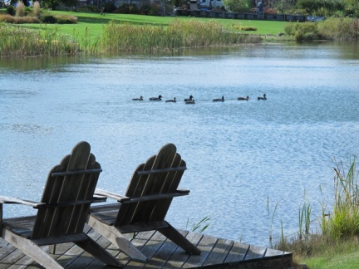
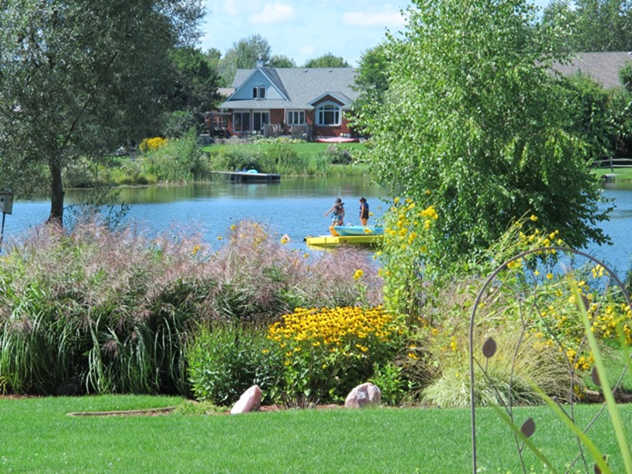
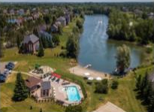
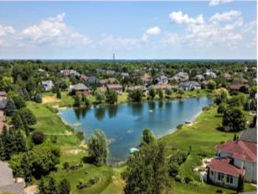
3a: Lakes & Ponds Water Quality Committee
Committee Objectives
  Stewardship
  Vegetation removal
  Community Support &
  Participation
Water Sampling
Lake Reports
Budget
AGM 2019

Slide 7
3a: Lakes & Ponds Water Quality Committee
Committee Objectives
  Stewardship
  Members of committee from all 4 lakes to monitor particular requirements of each lake;
  Oxygenation systems presently in all lakes
  b. Vegetation removal
  Residents encouraged to remove debris before it decomposes;
  Vegetation removal planned for lakes in 2020
  Community Support & Participation
  Residents encouraged to use low nitrogen and phosphate fertilizers;
  Residents encouraged to maintain septic systems
AGM 2019

Slide 8
3a: Lakes & Ponds Water Quality Committee
2) Water Sampling
Lake Sampled (August 2nd, 2019) | NITRATE LEVEL (N-NO3) | E. COLI LEVEL
Sunset Lake | <0.10 | 17
Twin Lake | 0.11 | 5
Misty Morning Pond | <0.10 | 7
Waterside Court Pond | <0.10 | 1
Ontario Drinking water objective for nitrate is 10.0 mg/l
City of Ottawa E. Coli guideline “Ottawa Public Health will issue a no-swim advisory if: the geometric mean of 5 water samples taken on the previous day is > 200 E.coli /100ml of water; or a single water sample result from the previous day is greater than 400 E.coli/100ml; or there is a significant rainfall event”
AGM 2019

Slide 9
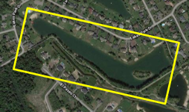
3a: Lakes & Ponds Water Quality Committee
3) Operations Sunset Lake
“Sunset Lakes has 6 bubbler lines and 2 diffusers operating throughout the 15-acre lake. This water body is by far the largest in area and water volume and is the ultimate recipient of almost all storm water from the community. The water quality has remained high throughout its history however issues of weed growth and clarity appear from time to time. This summer e-coli is slightly higher possibly due to significant increase in waterfowl. Nitrates are nondetectable where sampling indicates no evidence of septic contamination. Water quality sample results were excellent in all four lakes. ODS Marine was unable to attend to vegetation removal so we will work on a plan for next year. The oxygenation program appears to be working well. Algae bloom still occur particularly following periods of rainfall after lawn fertilizers have been applied. We urge residents to avoid and discourage the use of lawn fertilizers and increase the use of lawn irrigation for healthy lawns.
AGM 2019

Slide 10
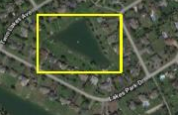
3a: Lakes & Ponds Water Quality Committee
3) Operations Twin Lake
Overall, another good year with the quality of the lake remaining very good. Like the other lake and ponds, the monitoring of E. Coli showed levels well below levels of concern for recreational use. The bubbler system (4 distributed over the lake) worked well in maintaining good clarity and water quality. The surface algae growth was lower than last year particularly at the North and South ends of the lake. A surface skimmer system (similar to the one used in South Pond) was installed at the South end of the lake and has worked very well (Jody Curran offered to host the skimmer and it was very much appreciated). Note that this skimmer was purchased at the end of the season of 2018. There was very good engagement, discussion and cooperation from many homeowners around the lake concerning water quality issues, use of rakes to maintain property beaches and overall lake management. I would like to acknowledge the significant work that the students earning community hours for school did this summer. They did a great job clearing the algae and weeds along the edge of the common areas around the lake. Special thanks to the Rideout's for arranging this student work service and I would highly support it again next year.
For planning next year (summer 2020) and as the budget allows, we would like to see dredging of the lake for weeds as well as possible installation of a second surface skimmer at the North end of the lake near the culvert where a lot of algae and weeds accumulate. This will be highly dependent on getting homeowner approval to host the power for the skimmer.
AGM 2019

Slide 11
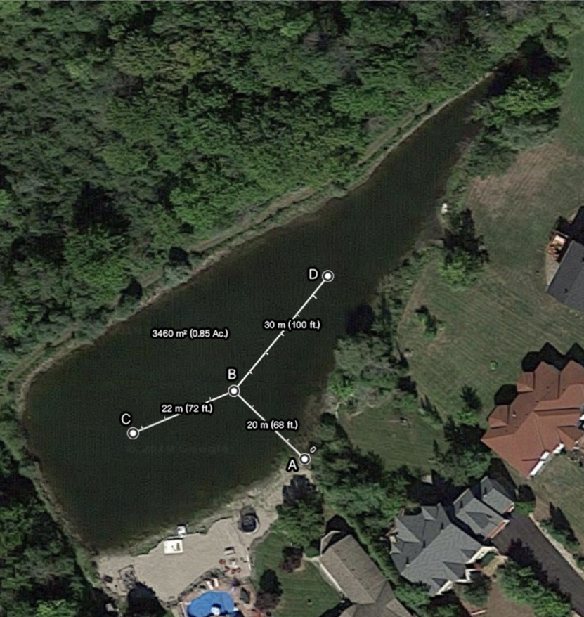
3a: Lakes & Ponds Water Quality Committee
3) Operations North Pond
Early this season we installed the two air diffusers, and air pump system according to the aeration plan or the North Pond (see image on the next page). The system has been running 24/7 since July. In the time since installation there has been an, albeit subjective, improvement in water clarity. Low levels of E-coli and nitrates shown in summer testing indicated good water quality, suitable for swimming. The pond does have some large chara algae blooms that have been partially removed. More work is required. Next year we would like to study the power consumption of the aeration equipment.
AGM 2019

Slide 12
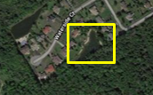
3a: Lakes & Ponds Water Quality Committee
3) Operations South Pond
Both the submerged bubbler and surface aerators ran all summer. Algae was significantly reduced, and water clarity was very good. Surface plants at the west end of the pond were well controlled. South pond residents have the spring install and fall removal down to just an hour at each end of the season. Great little projects to get to know the neighbours.
We’ve planned for vegetation removal on the south pond for a few years now, but it gets deferred because the company can’t find the time. I would recommend that we hire a company to do it next year. It’s never been done in the 17 years we’ve been on the pond. Other than veg removal, I’m not seeing a need for any large expenditures on the south pond and would be satisfied with a similar budget as in 2019.
AGM 2019

Slide 13
Lakes & Ponds Water Quality discussion
Question was raised from the floor regarding the mechanical configuration of the surface aerators. Lakes & ponds water quality rep (Russel Shearer) described how the surface aerator worked. As there is a potential for injury should someone put their hand into the blades of the aerators, SLOA Communications will put out a reminder advising residents to remain at a safe distance from the clearly visible aerators while using the lakes.
Discussion explaining why the planned weed removal was NOT carried out this year due to a variety of reasons, the main one being that the weed removal company was too busy and could not be booked. Membership informed that there is planned commercial weed removal for summer 2020, conditions permitting
No concerns raised by the membership regarding 2019 or 2020 budget for lakes.

Slide 14
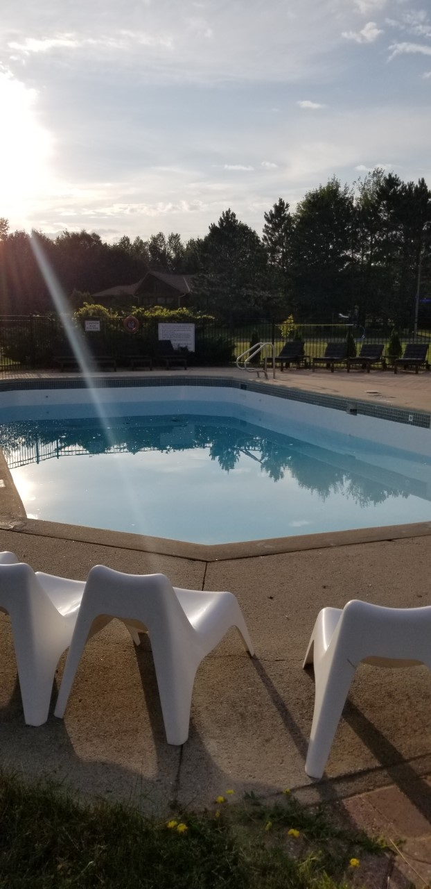
3b: Community Pool and Common Areas
We had another successful summer at our community pool
Opened late July following completion of work approved at AGM 2018.
  Final work came in $6200 under budget
AGM 2019

Slide 15
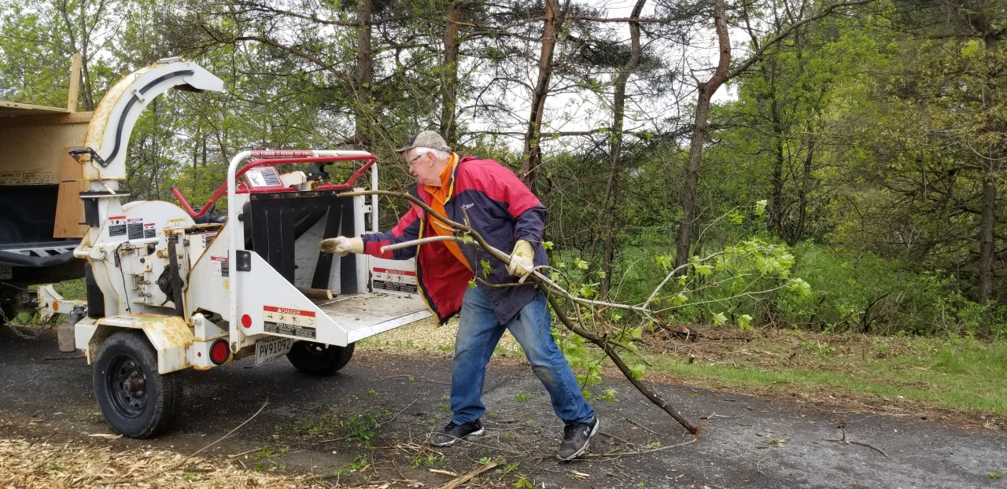
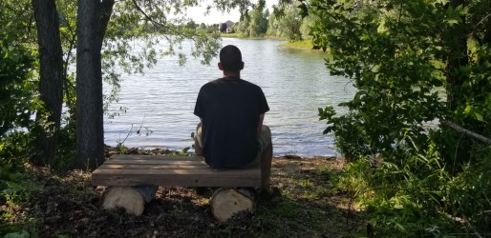
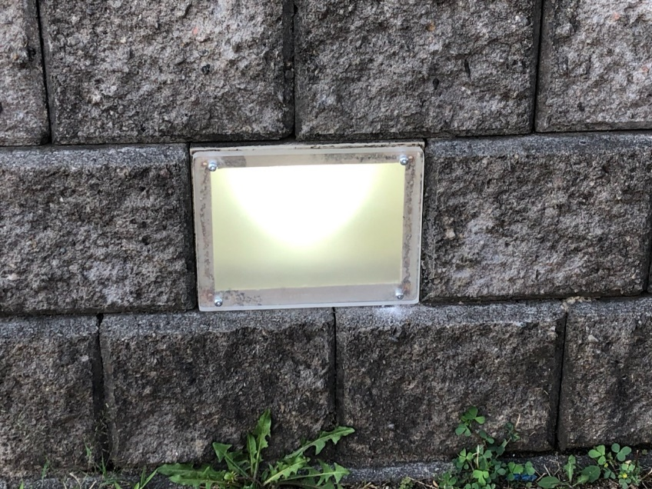
3b. Community Pool and Common Area
Work achieved
Pool entrance system installed
Pool Mechanical System updated to meet code
Tables and Chairs refurbished
Pathway rejuvenation phase 1
11 new trees planted in playground
Bank at Tranquil Gate sodded
Old Prescott entrance rejuvenation phase 1
Pool deck ground lighting repaired
Pool deck security light repaired
Rest benches placed
Parking lot light repaired
AGM 2019

Slide 16
Discussion re Pool and Common areas
Work completed by community volunteers summarized.
Concern expressed re planting of trees in playground area and potential obstruction of view to lake, responsibility for maintenance, etc. Question was raised whether the tree planting was submitted to the design review committee for approval. Response from board was that they were planted within covenant regulations and within approved budget and workplan.
Concern expressed over the brightness and large illumination footprint of the repaired light on the pool deck and of the repaired parking lot light. Board will investigate remediation options. Likely remedies to be considered are: light shielding/shroud to mitigate unnecessary illumination, light sensors to ensure that lights only activate at night and motion sensors to ensure that lights illumination only when movement is detected, in order to reduce the amount of time that lights operate, reduce electricity usage and reduce ‘light pollution’.

Slide 17
3b: Pool and Common Areas
Work planned for 2020
Pool Security System Upgrade
Old Prescott Entrance enhancement Phase 2
Repair basketball area
Restoration/repairs of paved walkways
Beach restoration (new sand)
Pathway rejuvenation Phase 2
Pool chemical system upgrade
AGM 2019

Slide 18
Pool and Common Area discussion, cont…
2020 planned work outlined to membership. Comments re security system and pool chemical system recorded following their detailed presentation (see further in ppt). No other planned work generated discussion.

Slide 19
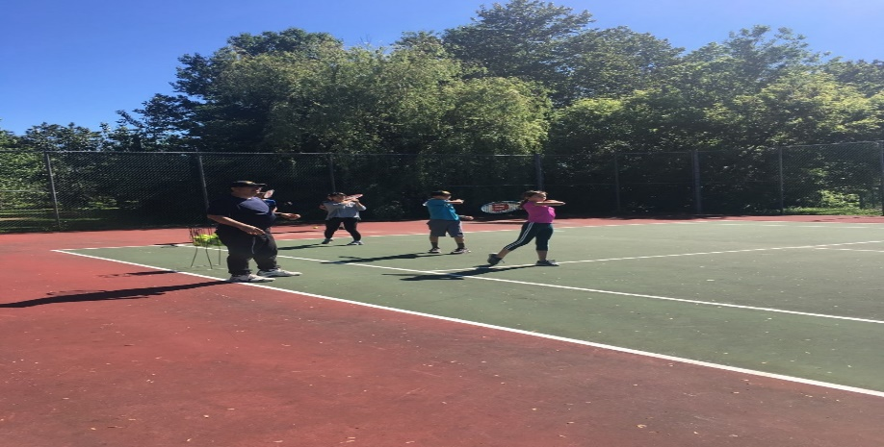
3b. Tennis Courts
Work Achieved 2019
Repairs to fencing and gates
Installation of new net
Pickle ball courts installed
Work Planned 2020
Surface repair of north court
Repair of fence post bases
Lifecycle plan developed including future resurfacing, fencing and addition of pickleball markings
AGM 2019

Slide 20
Pool Water Regulating Upgrade
Challenge
  Our current practice is to manually test the pool water 3 times per day. Each test takes approximately 30 minutes on site.
  The City Health and Safety Inspector has identified that standard required is
    Manual testing every 2 hrs
      or
    Result recording every 4 hrs (opening, noon and 1600 hrs) if using automated self feeding chemical system
    Current Pool maintenance requires 90 min/day. We do not have capacity to increase to 5 hrs per day. (in reality amounts to continuous 14hr/day continual presence)
AGM 2019

Slide 21
Pool Water Regulating Upgrade
Motion 3:
  The board is authorized to spend up to $8000 +/- 10% to cover expenses related to the purchase and installation of a self-regulating chemical system, if reasonable search does not reveal a less expensive mode.
  Motion raised by Doug Thompson, 2nd by David Bennett. Motion approved
  Before the motion was tabled, some discussion regarding our obligation to adhere to Ottawa Public Health Inspector report, specifically manual recording of chemical readings. Board explained that was in our best interest to adhere to inspectors report but would investigate potential for automated recording mechanism. No volunteers to manually check chemicals required that checks be made and recorded every 2 hrs, no other solutions brought forward.
AGM 2019

Slide 22
Pool Surveillance System
  Challenge
    The pool and beach area experiences episodic episodes of vandalism and mis-use ranging from destruction of property, trespass and tainting of pool water
    This past summer saw an observed increase in these activities as compared to the previous 2 years
    The current video surveillance system is outdated and non-functional
AGM 2019

Slide 23
Pool Video Surveillance System
Motion 4:
  The board is authorized to spend up to $5000 +/- 10% to cover expenses related to the upgrade of the pool security and monitoring system
  There was discussion regarding privacy vs. community safety and security of amenities, as a concern regarding privacy was raised. Those in attendance preferred to do a more thorough investigation of the issues and seek approval of the wider association before money was spent on repairing or replacing the current system, although the board still had the authority to proceed with the purchase
  Motion 10 was raised to defer motion 4 pending further study but that deferring will not affect current 2020 budget. Community approval required before any installation. Motion failed. Board agreed to seek input from residents living adjacent to the pool area, in order to ensure all privacy concerns were addressed. Motion 10 Failed. Motion, as originally raised, was approved
AGM 2019

Slide 24
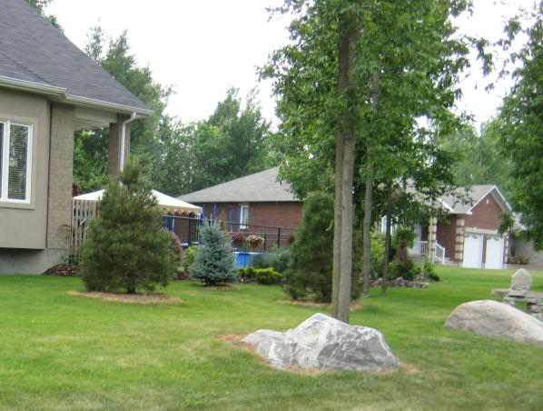
3c: Covenants and Design Review
DEED RESTRICTIONS... available online @ http://www.sunsetlakes.ca/owners-association-5/owners-association-3/covenants-and-restrictions
All building plans must be approved by Design Review Committee
Waterfront development must be approved
Trail easements cannot be constrained
No long-term parking of trailers, motorhomes, boat etc over 3wks
AGM 2019
Notes:
Dan

Slide 25
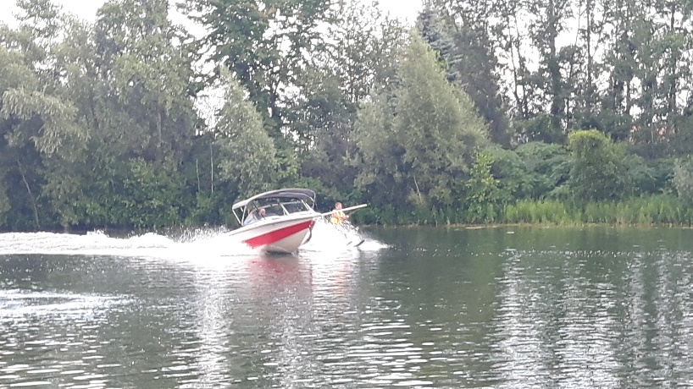
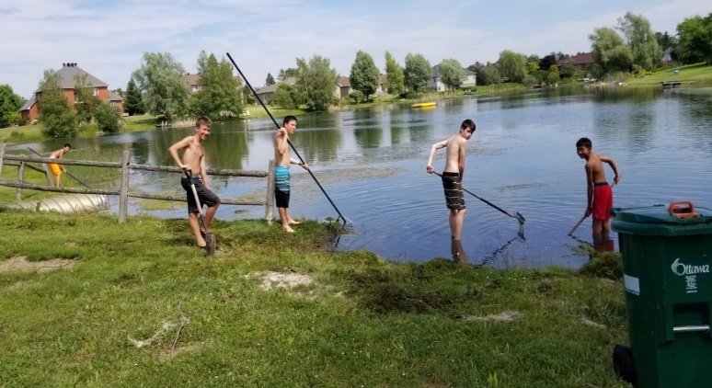
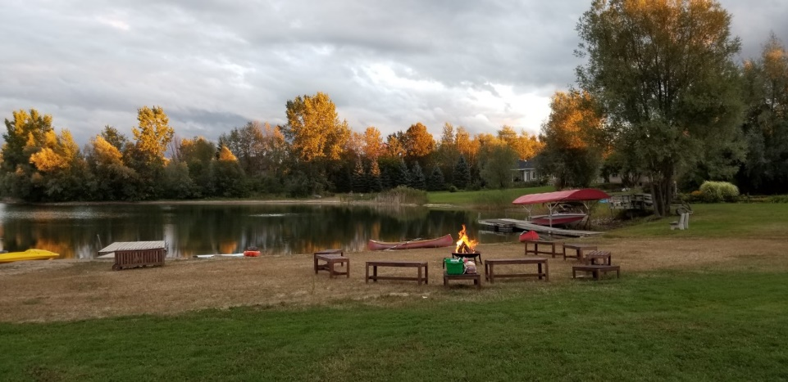
3d: Community Events and Social Activities
Spring and Fall Clean-up Days – Keeping our community beautiful
Weekly tennis lessons held at our tennis courts in Spring (paid by participants).
Brad the Balloon Guy
Sunset Rock Art and Facebook page
Welcome Summer Pool Party with live DJ
SLOA ‘Dive-in’ Family movie nights presented at the pool
Fairy Doors
Campfire Sing-along and marshmallow roast
TGIF with potluck meals,usually the first Friday of the month
Free water ski nights
Youth Volunteer Program
AGM 2019

Slide 26
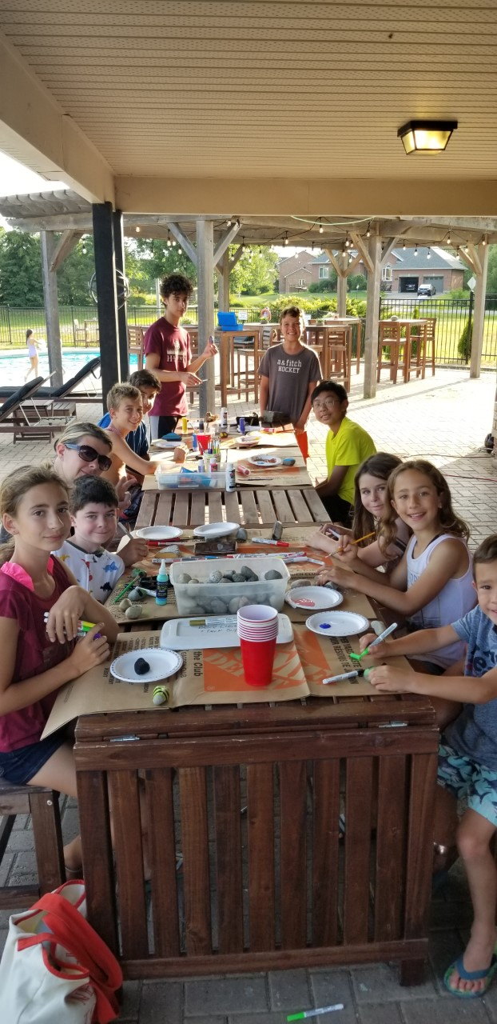
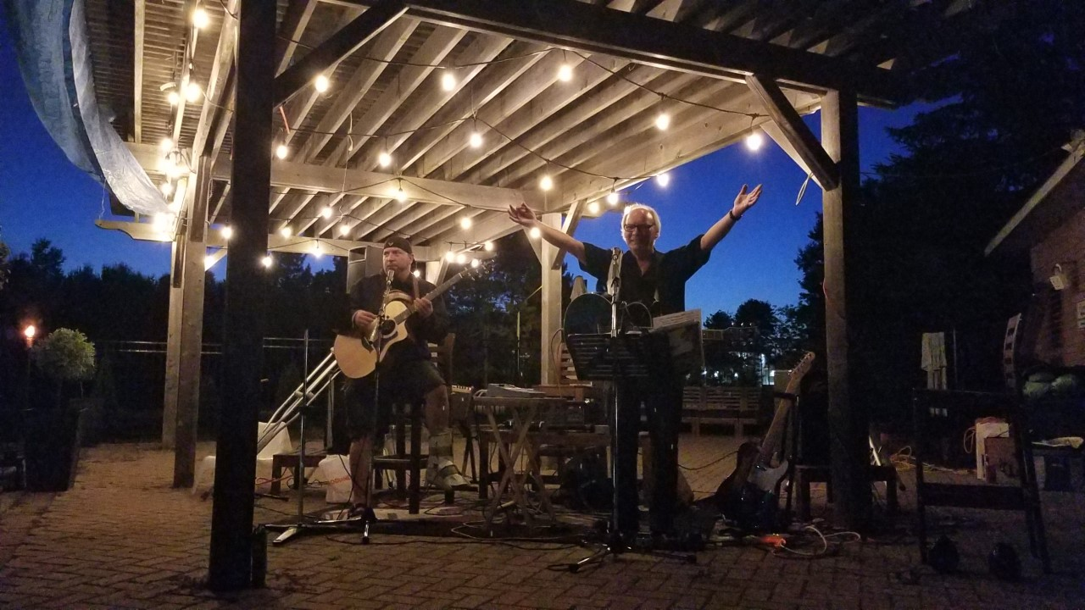
3d: Community Events and Social Activities
Events are open to all residents in good standing and accompanied guests. We look forward to seeing our neighbours in 2020 at our community events
AGM 2019

Slide 27
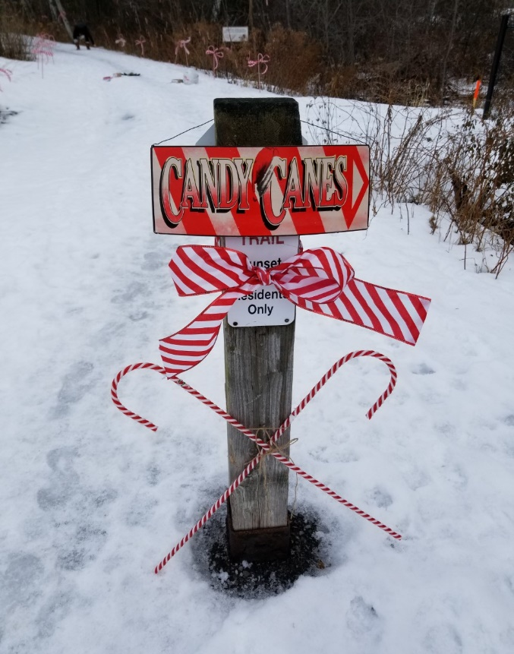
Holiday Tree Lighting and
Candy Cane Lane Scavenger Hunt
Cookies and bonfire to follow
Tentative date Sunday 8 Dec 2019
AGM 2019

Slide 28
3e: SLOA Communications
All communications from SLOA are via email
It is the responsibility of all SLOA residents to provide SLOA with an active email address
Email addresses collected by SLOA are not shared. All SLOA communications are sent out using blind carbon copy (bcc)
SLOA email distribution list is ONLY to be used for the dissemination of information that is pertinent to the ENTIRE community (emails directed to lost/found items or pets, vandalism/public safety concerns, SLOA organized activities…)
- Personal advertisements, charitable causes, fund raisers, house sitting, etc..., no matter how laudable or beneficial the cause, DO NOT meet the standard considered suitable for dissemination via the SLOA email distribution list.
Launched SLOA Community Facebook Page! (currently 54 members; please join)
NOTE: The SLOA Facebook page is recommended as an option for residents wishing to inform the community of other non-SLOA events, opportunities, activities, etc…
AGM 2019

Slide 29
3e: SLOA Communications
To contact SLOA, send an email to the SLOA email address – sloa@rogers.com
Reasons to contact SLOA:
To submit a Design Review request
To register an up to date email address to receive communication
To inform re: safety concern (eg. criminal activity, vandalism, suspicious behaviour, wild animals, etc.)
To report lost and found items (i.e. pets)
To report possible covenant violations (anonymity assured)
NOTE: SLOA Facebook page is recommended as an option for residents wishing to inform the community of other non-SLOA events, opportunities, activities, etc…
AGM 2019

Slide 30
SLOA Communications discussion
Question was raised from the floor regarding how the board arrived at its decisions and that all minutes should be disseminated to residents. It was relayed to audience that an volunteer board such as SLOA does not have enough human resources to do this but highlighted that minutes of discussions are retained by the SLOA board secretary, that these minutes are available to any resident upon request and that all board meetings are open to any resident who wishes to attend. Resident expressed that residence had their opportunity to influence board activities at the AGM and through approval of budget but that having to seek input from community on all board activities would unreasonably impede board from carrying out its functions
Question was raised from the floor regarding how emails to sloa@rogers.com were processed. The board indicated that the communications member was the sole recipient of all incoming email. That person was responsible for handling/directing the email/topic as they believed appropriate. This has been standard practice for over a decade.
Motion from the floor
Motion 11: all incoming SLOA email disseminated to all SLOA board members
motion tabled by David Bennett. 2nd by Dianne Saulnier
Motioned voted on. Motion failed
AGM 2019

Slide 31
Item 4: 2019 Financial Report
 | Budget 2019 | Projected to year end
Income | 66,000 | 61,371
Operating Expenses
Administration & General | 5,000 | 4,406
Gardens and Landscape | 12,800 | 11,690
Pool Operations | 10,000 | 6,021
Lake Operations | 15,700 | 6,573
Community Events | 2,000 | 1,172
Repairs and Maintenance (other) | 1,500 | 2,577
Pool Security | 2,000 | 1,717
Walking Trail/Path Maintenance | 3,000 | 1,705
Total Operating Expenses | 52,000 | 35,861
Allocation to the Reserve Fund | (6,345) | (6,345)
Capital Projects – Pool Refurbishment | 25,000 | 18,797
Net Income/(Loss) | $(17,345) | $368
AGM 2019

Slide 32
2019-2020 Budget Comparison
 | Budget 2019 | Budget 2020
Income | 66,000 | 66,000
Operating Expenses
Administration and General | 5,000 | 5,400
Gardens and Landscape | 12,800 | 11,800
Pool Operations | 10,000 | 13,000
Lake Operations | 15,700 | 15,700
Community Events | 2,000 | 2,000
Repairs and Maintenance | 1,500 | 3,000
Pool Security and Access | 2,000 | 0
Pool Surveillance System | 0 | 5,000
Walking Trail/Path Maintenance | 3,000 | 2,000
Tennis Courts |  | 1,000
Total Operating Expenses | 52,000 | 58,900
Net Income/(Loss) after Operations | 14,000 | 7,100
Allocation to reserve fund | (6,345) | (6,345)
Capital Projects – Pool Refurbishment | 25,000 | 0
Net Contribution/(Draw on Reserves) | $(17,345) | $755
SLOA AGM November 25, 2015
AGM 2019

Slide 33
Financial Motions for 2019
Motion 5: To approve the 2019 financial report as presented.
Motion tabled by Chuck Hamilton :2nd by Ruth Desjardins. Motion approved
Motion 6: To approve the Sunset Lakes Owners’ Association NOT appointing an auditor to audit the 2019 financial statements.
Motion tabled by Dianne Saulnier; 2nd by Brad Keys. Motion approved
Motion 7: To approve the SLOA operating and capital budget for 2020
Motion tabled by Marl Saulnier; 2nd by Doug Thompson. Motion approved
AGM 2019

Slide 34

Reserves
We normally contribute 10% of total income to the reserve fund each year.
At the end of 2019, the reserve fund will be approximately $90,000.
Significant discussion regarding how much of a reserve was considered healthy. It was explained that the board would like to have someone asses value of current amentias and develop life-cycle plan. Cheryl Brekalo indicated interest in this area. Non-board member (Jean Louis Guertin) volunteered to verify actual account balance on behalf of membership.

Slide 35
2020 Fees due January 1st
2020 fees are $450 (no increase for the 2020 year)
A late fee of $50 will be accessed for all residents that are unpaid on January 2nd and then $20 per month for the next three months
Leave a post dated cheque here tonight
Or e-payment is now available for your convenience
Email to: deborah@boninitax.com
Mail your cheques to: 6798 Lakes Park Drive, Greely, K4P 1M6

Slide 36

Item 7: Volunteers Make the Community
All Board members are volunteers (no remuneration)
Volunteers can sit on special committees
Roughly 20% of households volunteer
You can help keep Sunset Lakes beautiful with:
Raking lake shorelines
Preventing overgrowth of grass on common walkways
Tidying up at the pool area
Community events
Weeding entrances and pool area
Participation in clean-up activities
Encourage your high school students to earn volunteer hrs
AGM 2019

Slide 37
More Volunteers needed
We are recruiting new board members
  Commitment is 7-10 meetings per year
We require non-board committee members to participate in projects such as:
  Pathway maintenance
  Tennis court maintenance
  Dock and Beach Maintenance – champion needed
  Pool Maintenance – champion needed
  Entrance Maintenance – more help needed
AGM 2019

Slide 38

Item 8: Election of the Board for 2020
AGM 2019

Slide 39
Slate of SLOA Board members for 2020
President/Communications: Dan Weslake
Treasurer: Sandi Bonini
Social: Lesley Rideout
Pool: Marc Saunier (ex-officio/unofficial, non-voting member)
Secretary: Lena Grygoryev
Common Area: Bill Rideout (ex-officio/unofficial, non-voting member)
Community Ambassador: Heather Counsel (ex-officio/unofficial, non-voting member)
Tennis Court: Marc St. Pierre
Amenities Manager; Doug Thompson
Reserve fund manager: Cheryllynn Brekalo
Security : David Bennet*
Motion 8: Motion to approve elected board members. Motion approved
* It was later determined, in April 2020, that the SLOA board, by comprising 8 official, voting members was in violation of sections 1.3 and 1.4 of SLOA By-law no. 1. This ‘over-capacity’ issue was resolved when David Bennet volunteered to resign from the board. His resignation accepted and subsequently confirmed at the first SLOA meeting of 2020.
* One voting member per household
AGM 2019

Slide 40

Item 9: Q and A session
Other Questions from the floor
AGM 2019

Slide 41
Item 10: Motion 9 - to adjourn the meeting.
Motion tabled by Cheryl Brekalo; 2nd by Mark Saulnier. Motion approved
AGM 2019

Slide 42
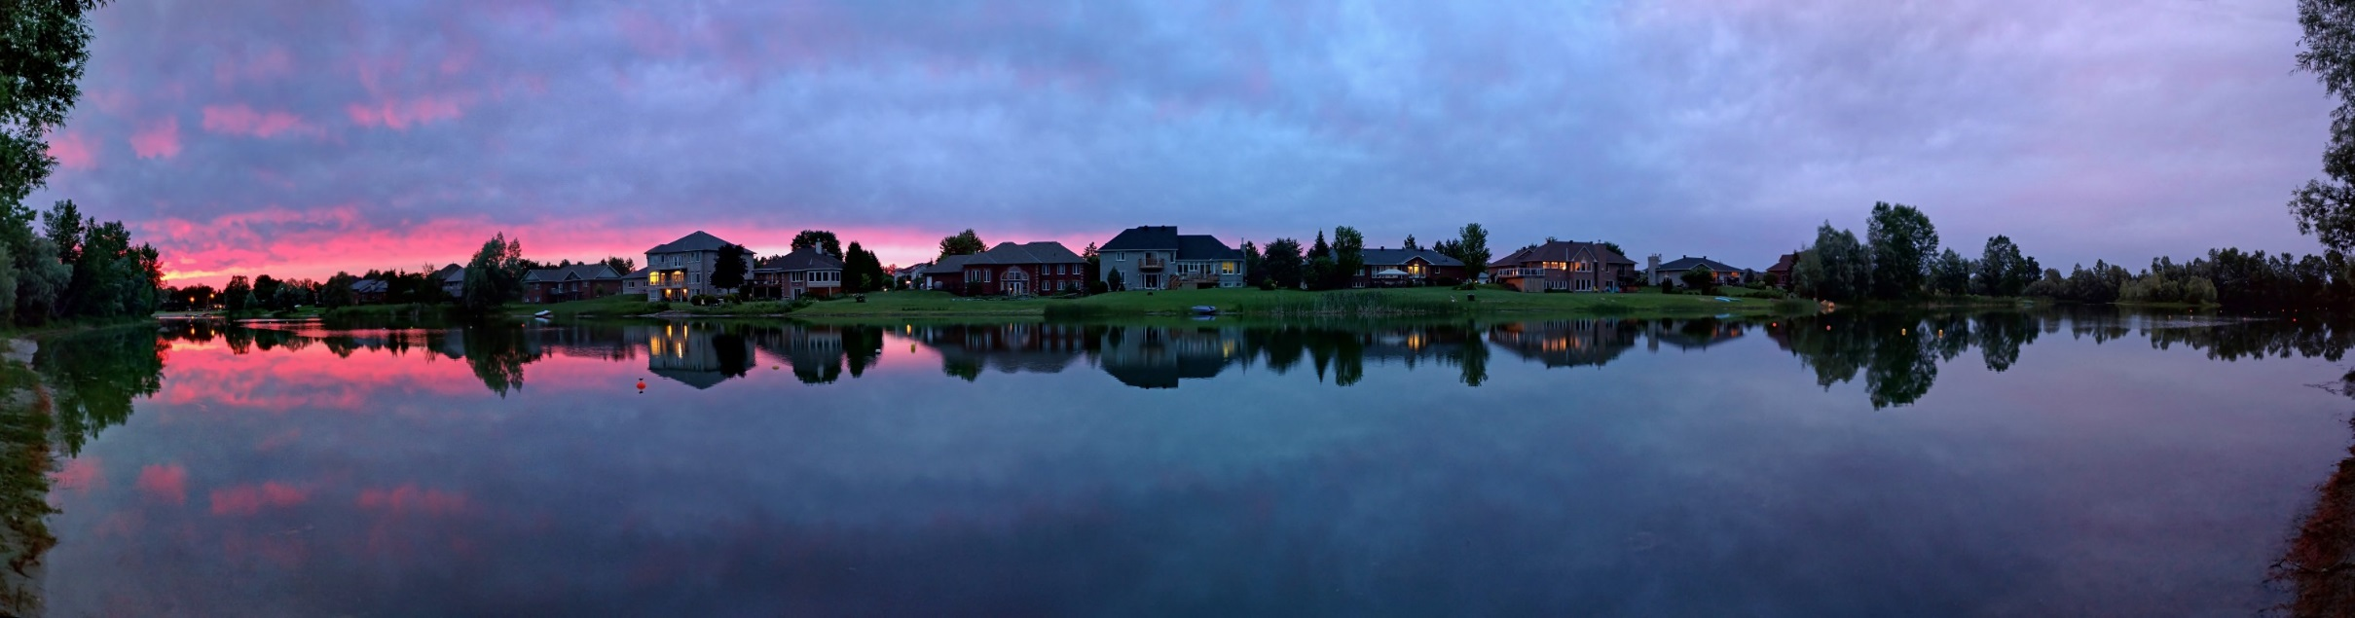
Thank you all for coming!

